Slide 1
UniT II

Slide 2
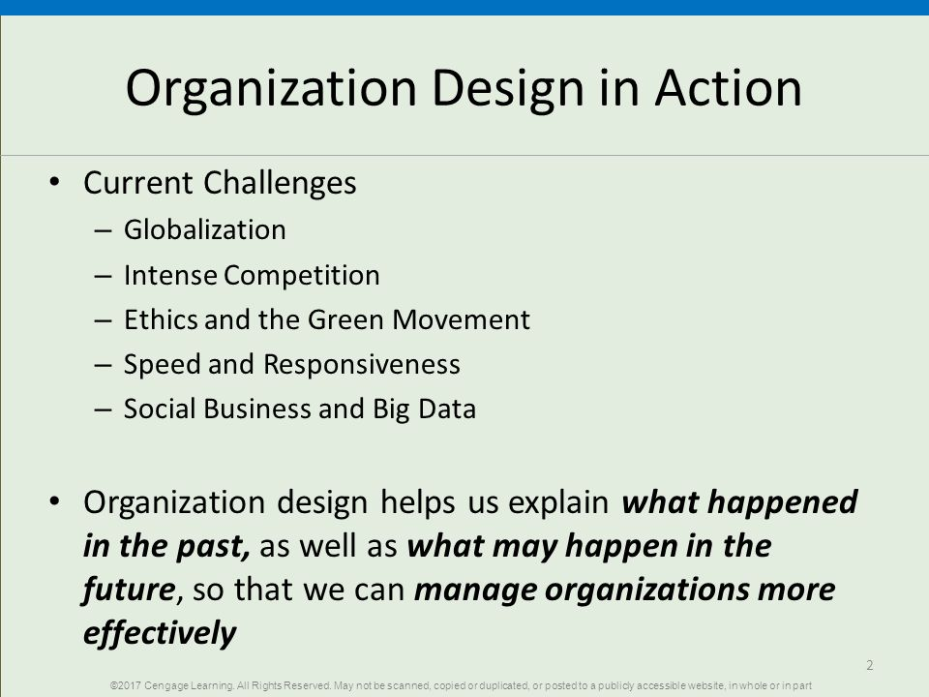

Slide 3
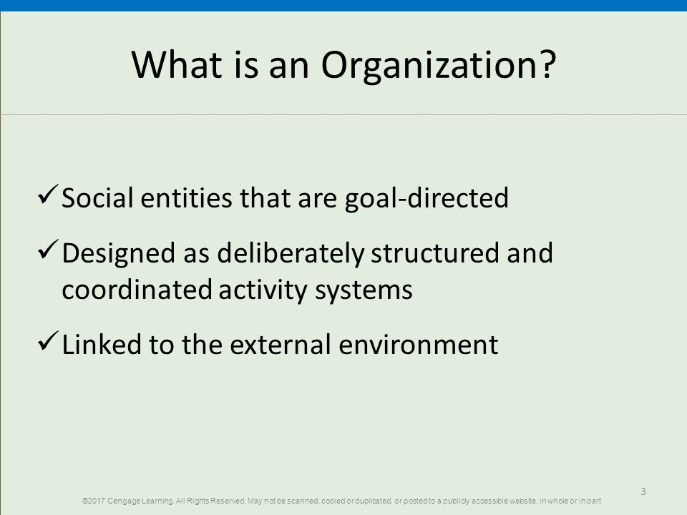

Slide 4
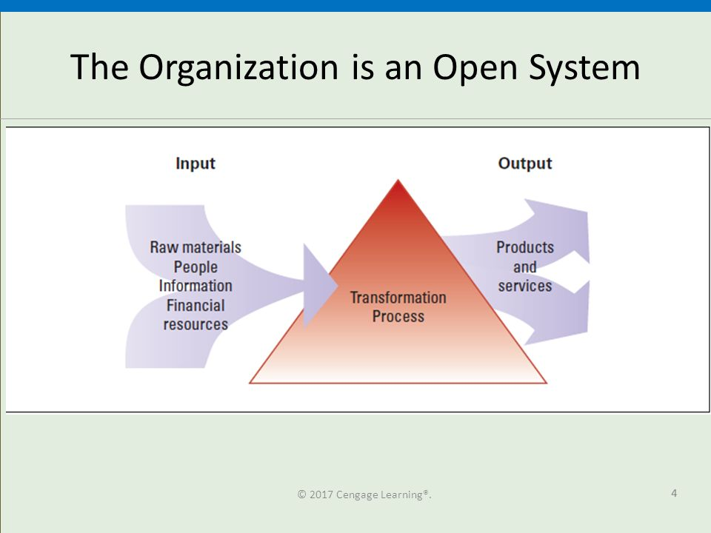

Slide 5
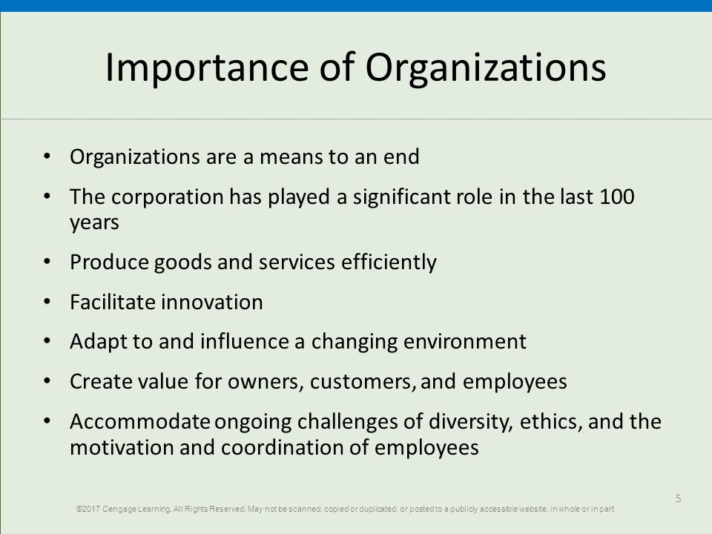

Slide 6
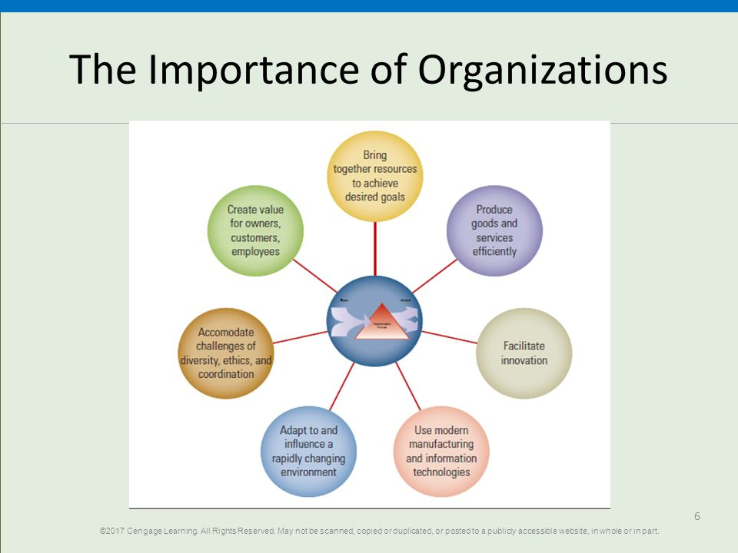

Slide 7
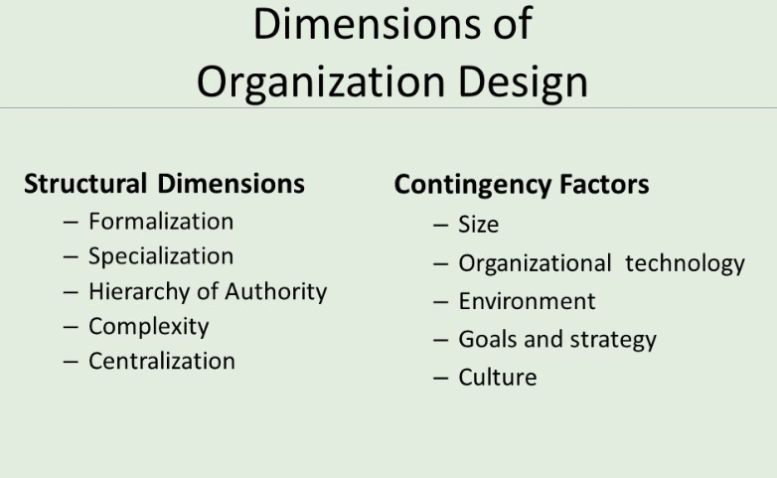

Slide 8
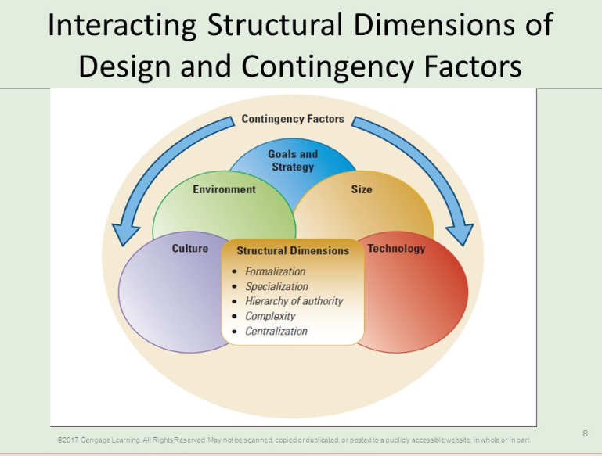

Slide 9
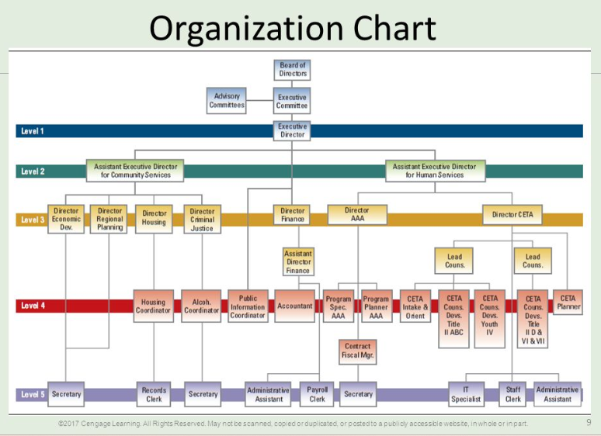

Slide 10
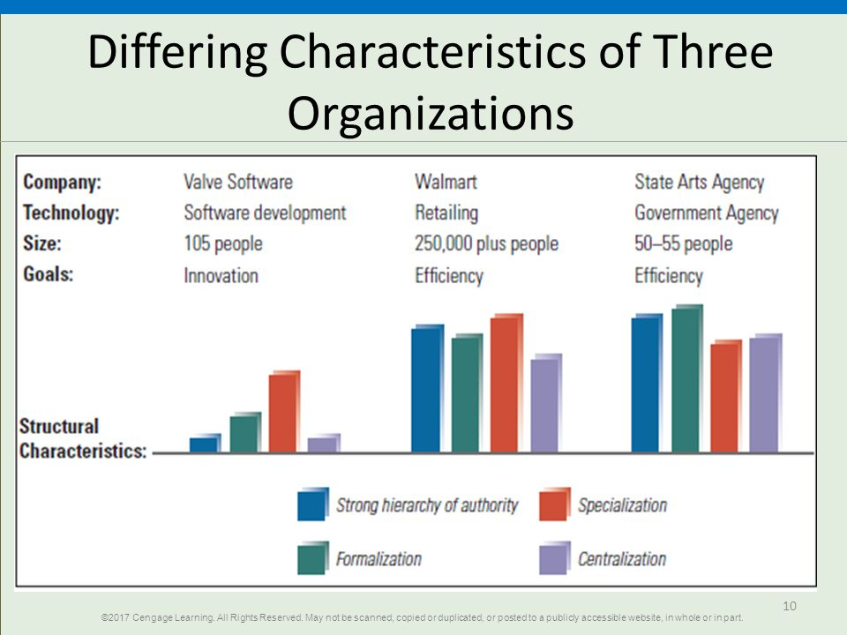

Slide 11
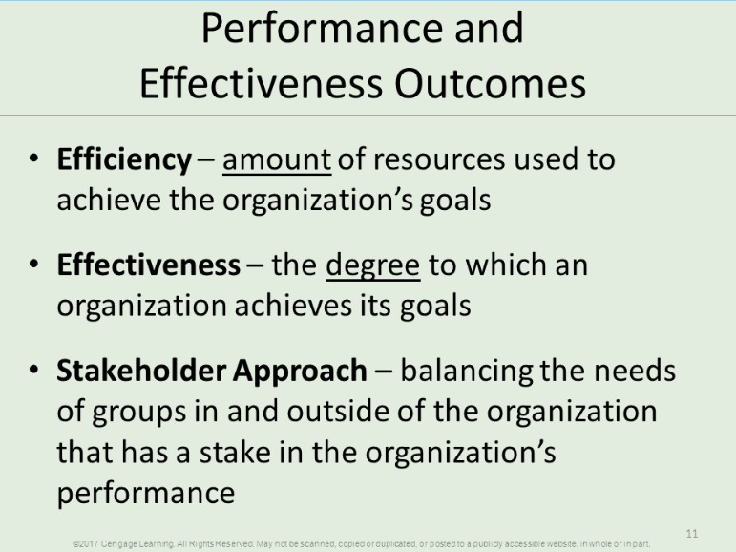

Slide 12
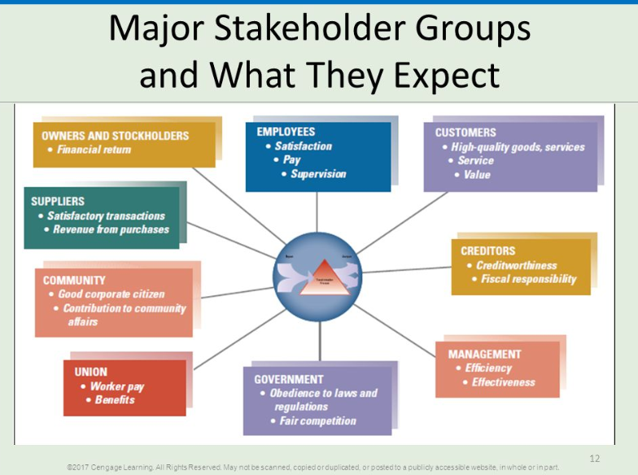

Slide 13
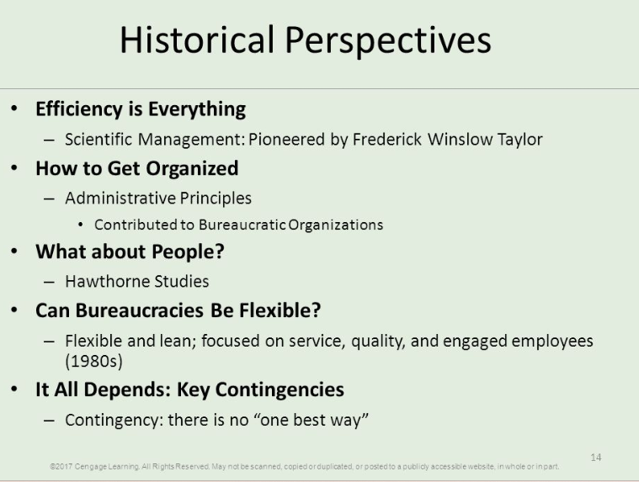

Slide 14
New vs. Old structure

Slide 15
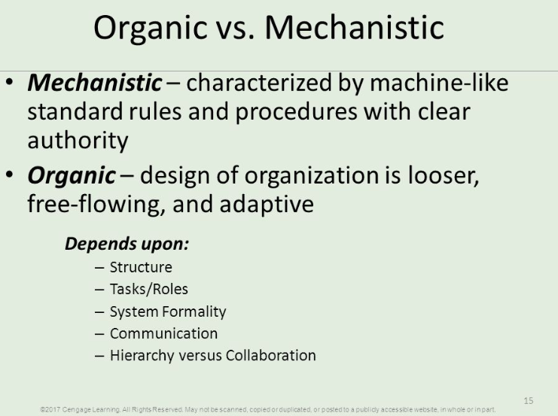

Slide 16
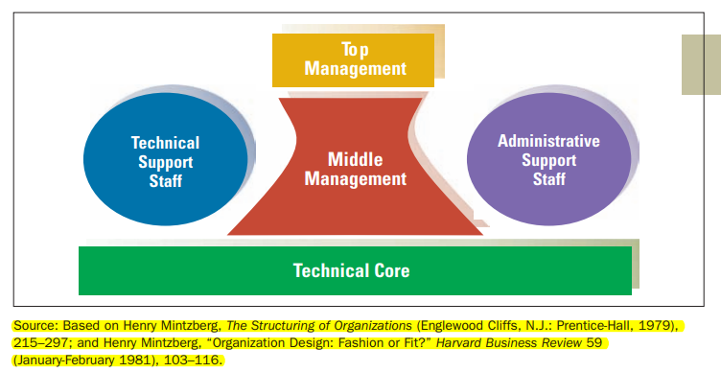
ORGANIZATIONAL CONFIGURATION -Five Basic Parts of an Organization
framework proposed by Henry Mintzberg
suggests that every organization has five include
the
technical core,
top management,
middle management,
technical support, and
Administrative support.

Slide 17
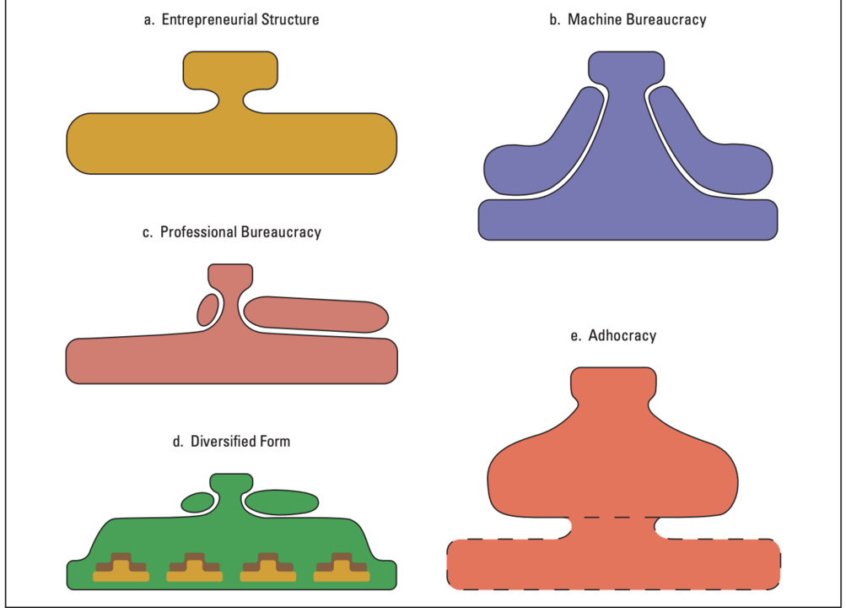
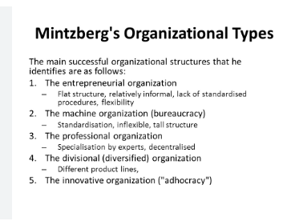
Mintzberg’s Five Organization Types

Slide 18
Organisational Design Decisions

Slide 19
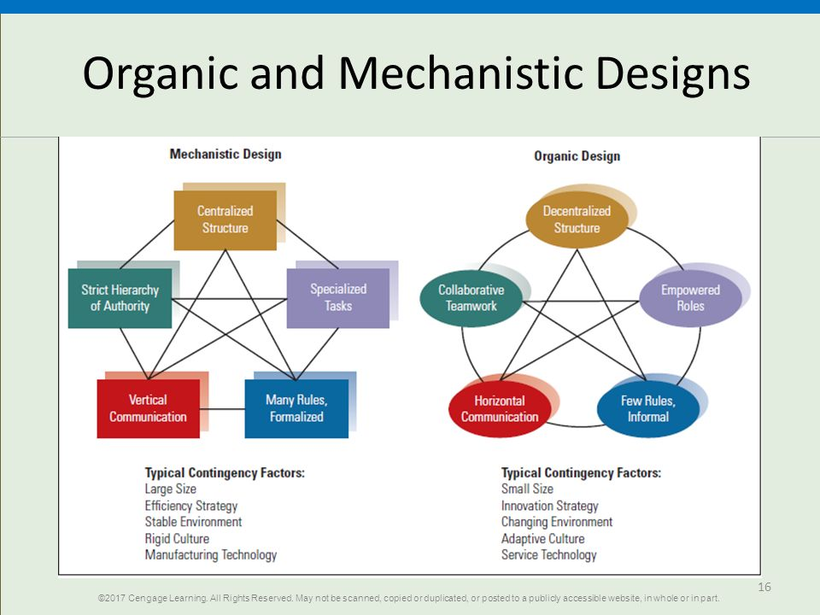

Slide 20
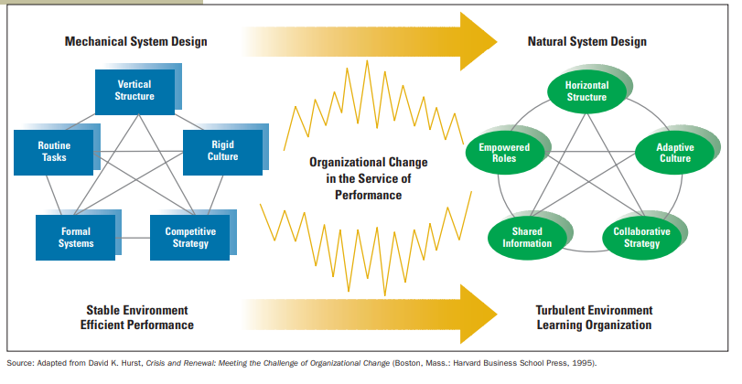

Slide 22
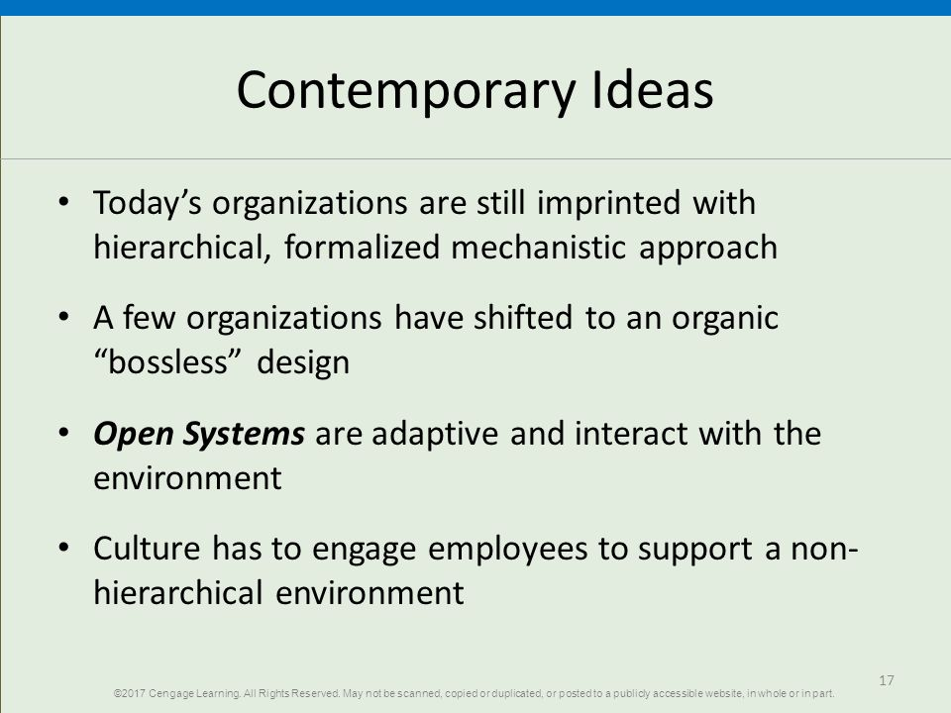

Slide 23
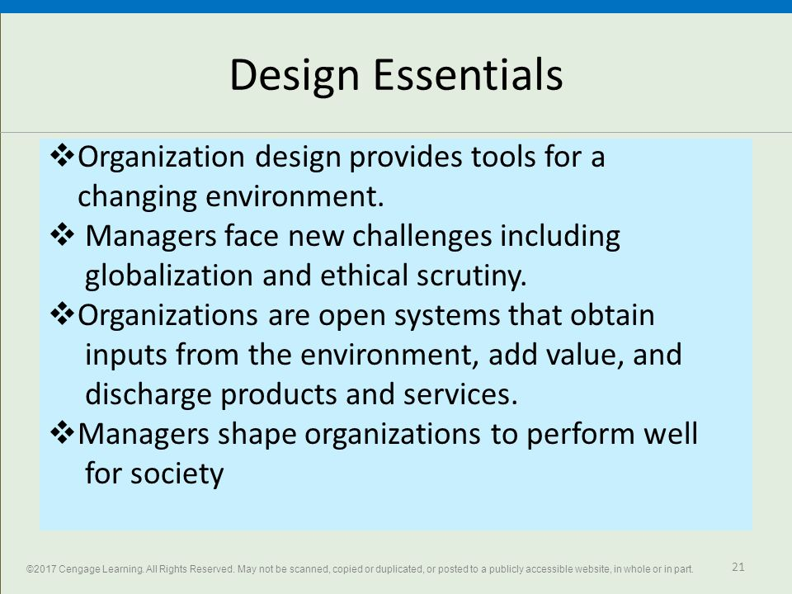

Slide 24
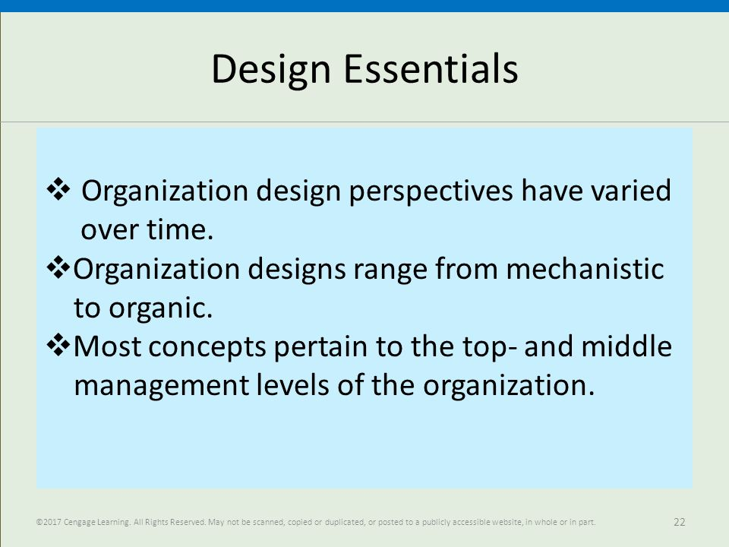

Slide 25
Basic principles
1. Organizational structure gives priority to key customers 2. The structure is able to reduce and eliminate organizational duplication 3. Structure simplifies layers of management within the organization. 4. The organizational structure can increase the channel of communication within the organization. 5. The organizational structure provides clear roles, responsibilities and accountability.

